Slide 1
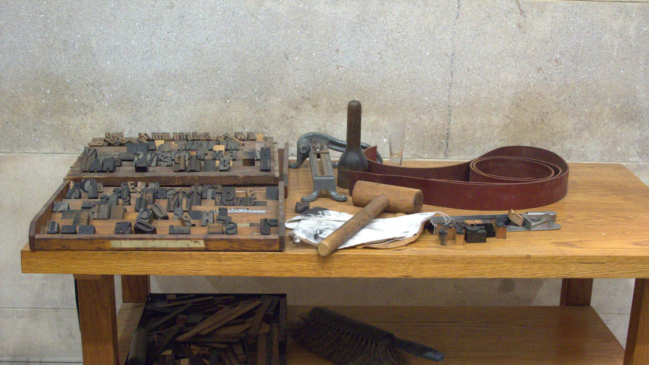
Class 15:
Script
Cryptocurrency Café
UVa cs4501 Spring 2015
David Evans

Slide 2
Plan for Today
Bitcoin Script
Language
Transactions
Reminders: Project 2 due tomorrow (that’s this Thursday not next)
Project Ideas: preliminary project proposal will be due March 19

Slide 3
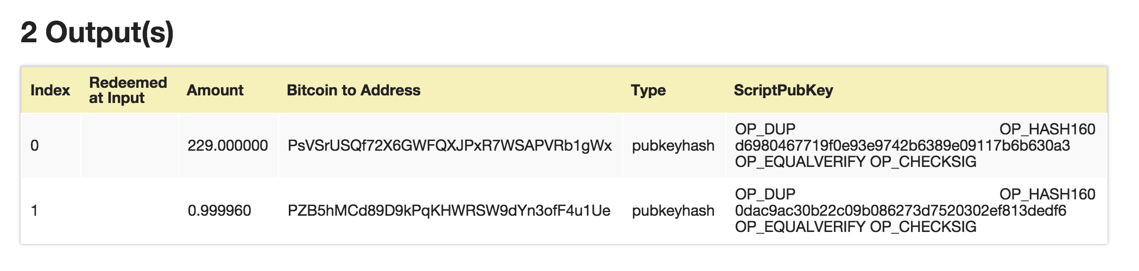
Bitcoin (and PointCoin) Transactions
http://blockexplorer.bitcoin-class.org/rawtx/f2d90b4ee862c328f42fb24ca5a84051a495af1de0f8d129a5b33cd98822719a
Transaction outputs include programs written in “Script”

Slide 4
Script Language
Stack-based (similar to JVML)
~80 opcodes (many have been deprecated)
Late addition to bitcoin design
Lots of limitations in what nodes will accept: altcoins are taking different approaches

Slide 5
Interpreting Script
OP_1
OP_DUP
OP_ADD
OP_DUP
OP_SUB
OP_VERIFY

Slide 6
Is Script Turing-Complete?

Slide 8
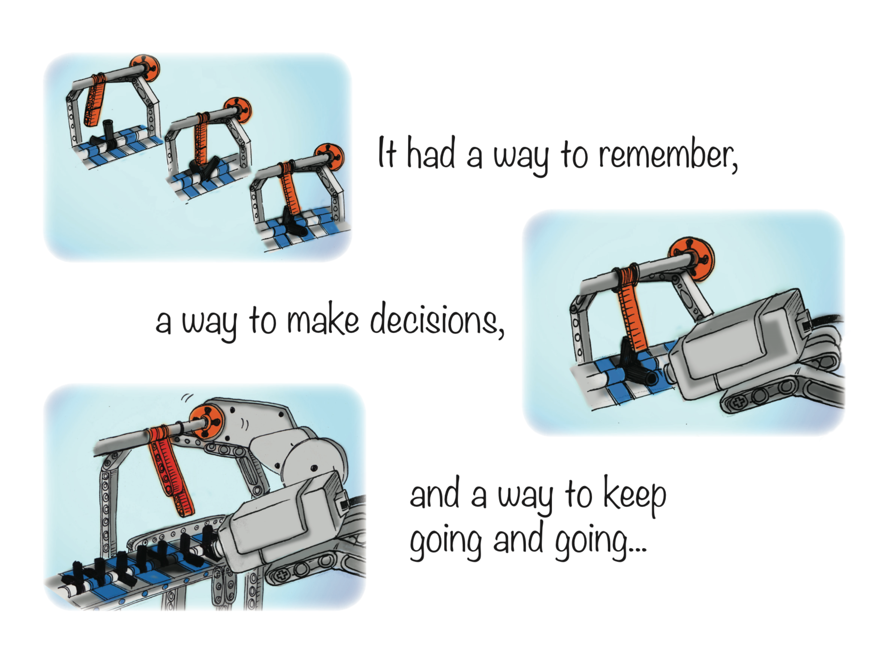


Slide 9

dori-mic.org

Slide 10
Interpreting Script

Slide 11
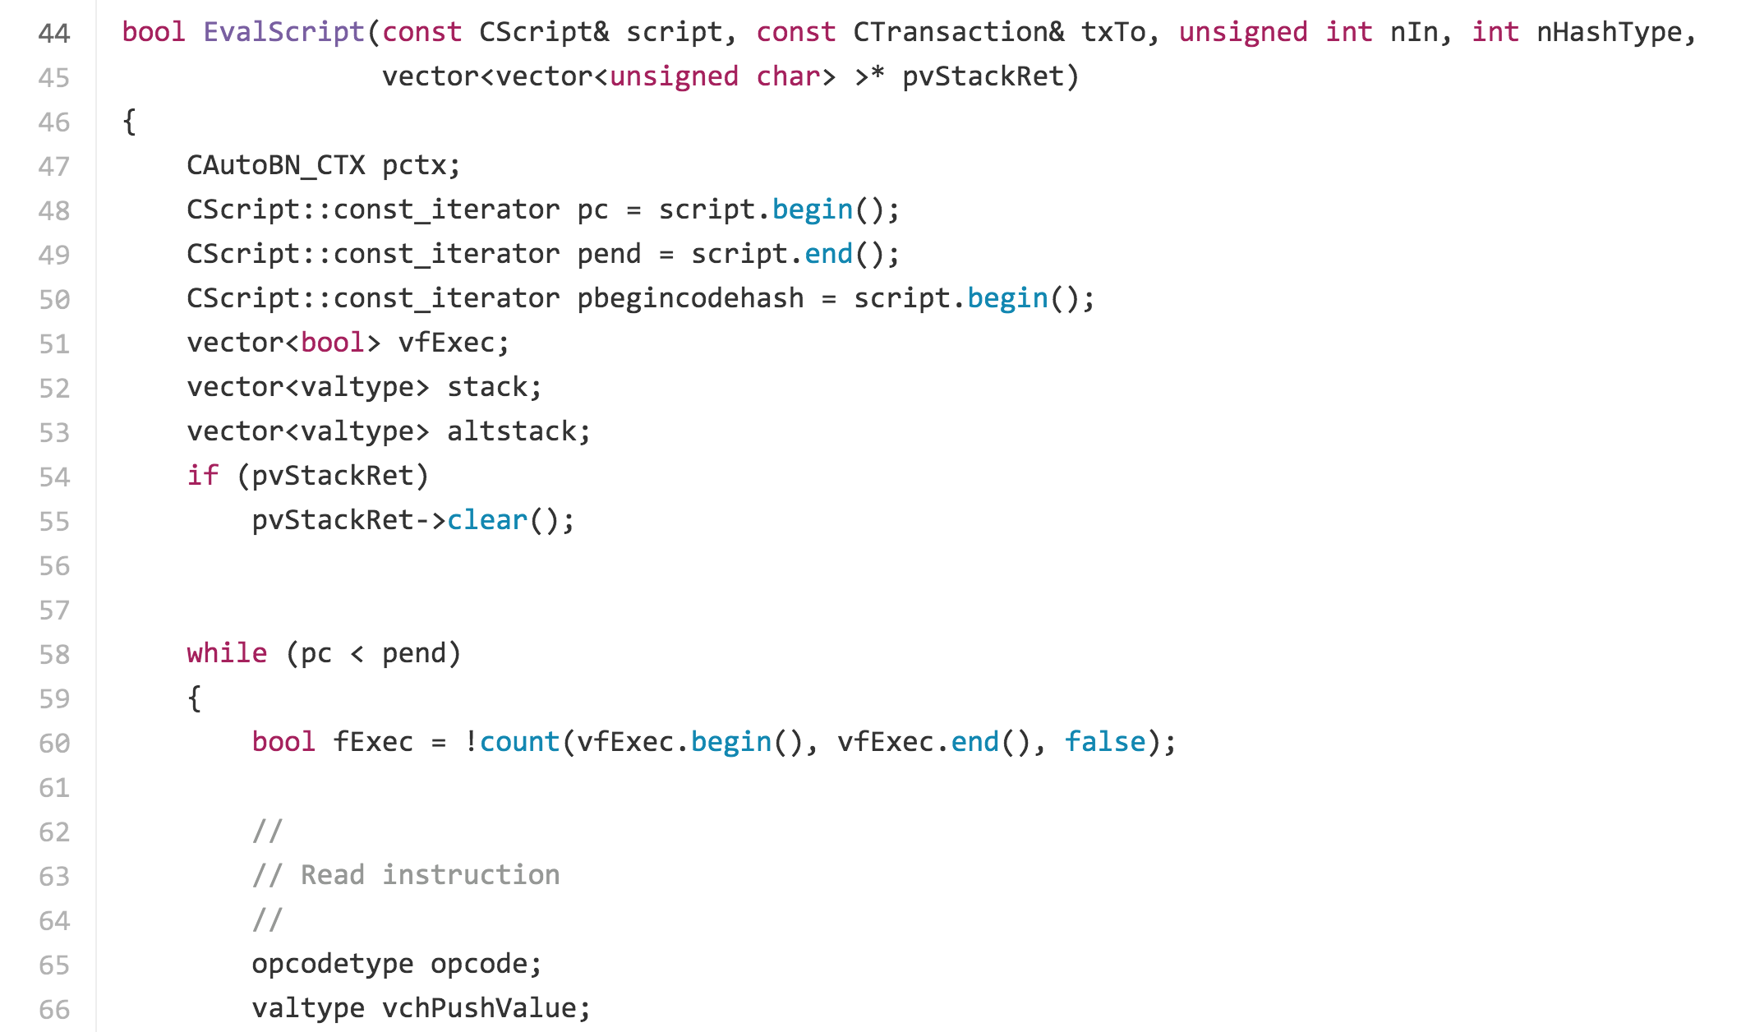
https://github.com/bitcoin/bitcoin/blob/v0.1.5/script.cpp#L41

Slide 12
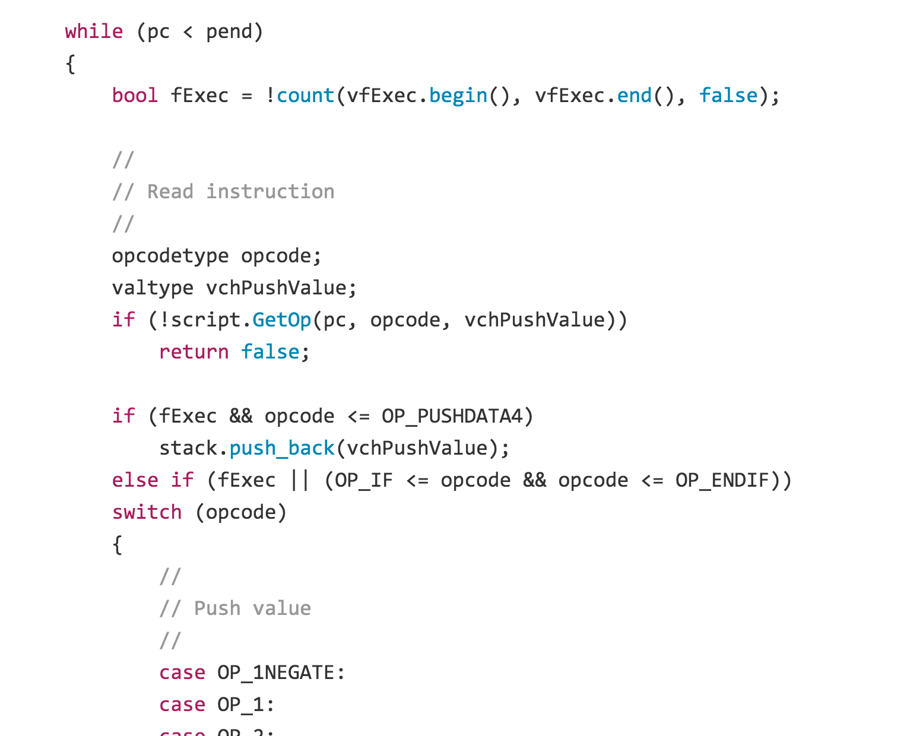
https://github.com/bitcoin/bitcoin/blob/v0.1.5/script.cpp#L58

Slide 13
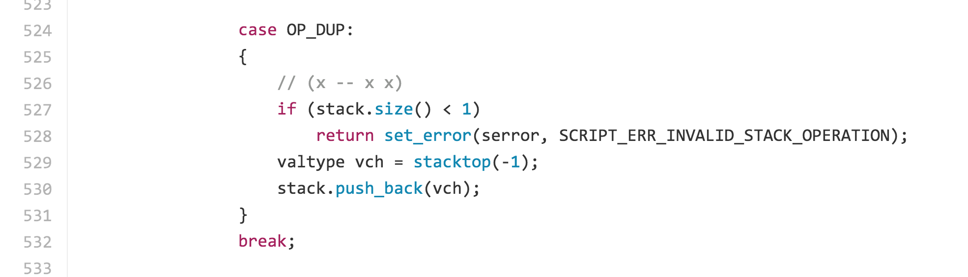
Interpreting Script
https://github.com/bitcoin/bitcoin/blob/41e6e4caba9899ce7c165b0784461c55c867ee24/src/script/interpreter.cpp#L524

Slide 14
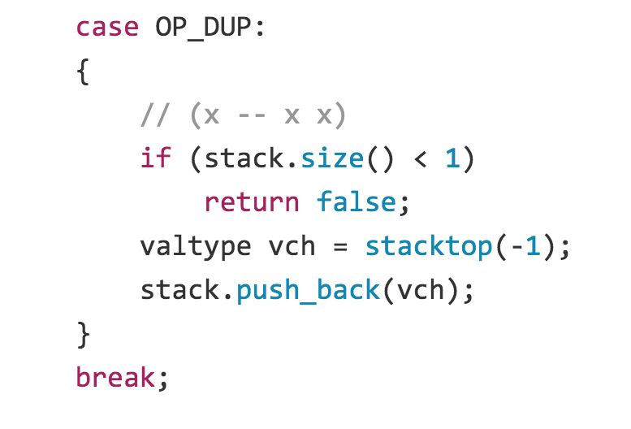
https://github.com/bitcoin/bitcoin/blob/41e6e4caba9899ce7c165b0784461c55c867ee24/src/script/interpreter.cpp#L524
Latest
Version 0.1
Project idea: look at how bitcoin core code has evolved over time

Slide 15
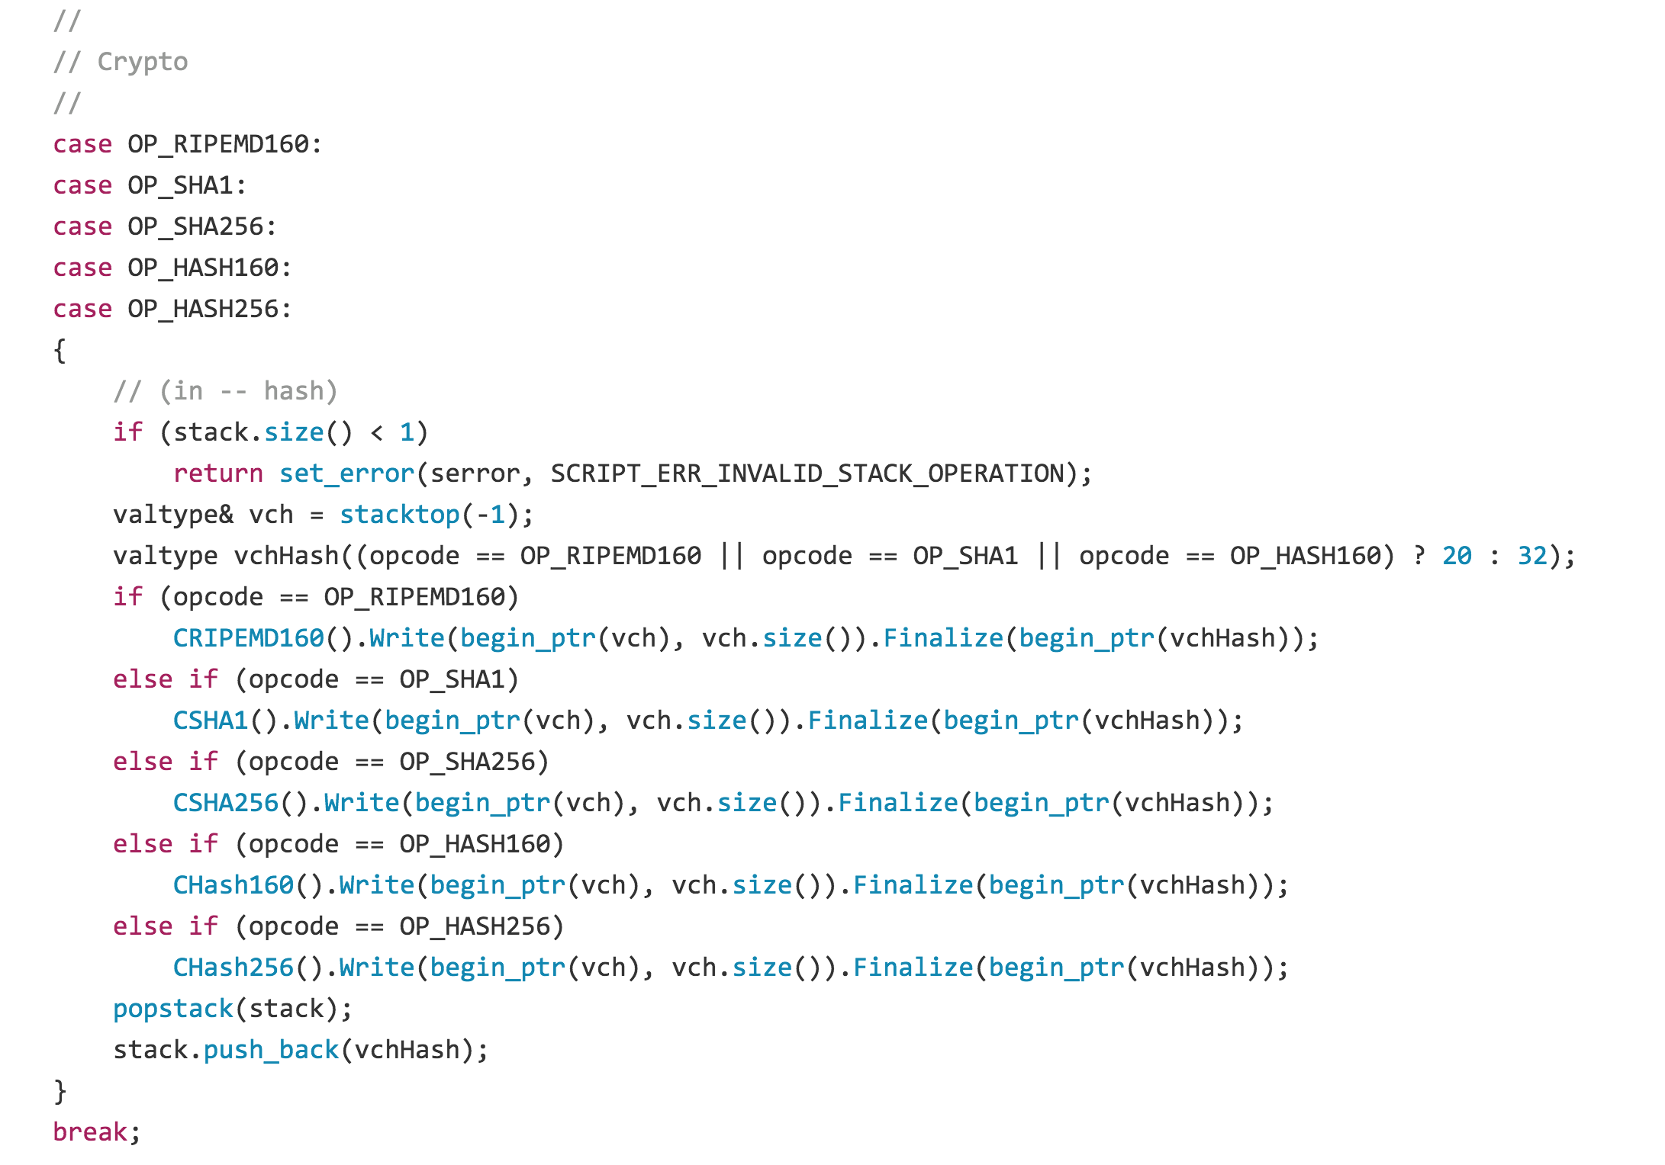

Slide 16
Vout: ([]btcjson.Vout) (len=2 cap=4) {
(btcjson.Vout) {
Value: (float64) 229,
N: (uint32) 0,
ScriptPubKey: (btcjson.ScriptPubKeyResult) {
Asm: (string) (len=85) "OP_DUP OP_HASH160 d6980467719f0e93e9742b6389e09117b6b630a3 OP_EQUALVERIFY OP_CHECKSIG",
Hex: (string) (len=50) "76a914d6980467719f0e93e9742b6389e09117b6b630a388ac",
ReqSigs: (int32) 1,
Type: (string) (len=10) "pubkeyhash",
Addresses: ([]string) (len=1 cap=4) {
(string) (len=34) "PsVSrUSQf72X6GWFQXJPxR7WSAPVRb1gWx"
}
}
},

Slide 17
OP_DUP
OP_HASH160
d6980467719f0e93e9742b6389e09117b6b630a3
OP_EQUALVERIFY
OP_CHECKSIG
Locking Script
OP_DUP [x] Duplicates the top stack item
OP_HASH160 [x] Replaces top of stack with RIPEMD160(SHA256([top]))
OP_EQUALVERIFY [x1] [x2] If top two items are equal, outputs True;
otherwise, marks transaction as Invalid.
OP_CHECKSIG [pubkey] [sig] Checks that E_pubkey(sig)([entire transaction])

Slide 19
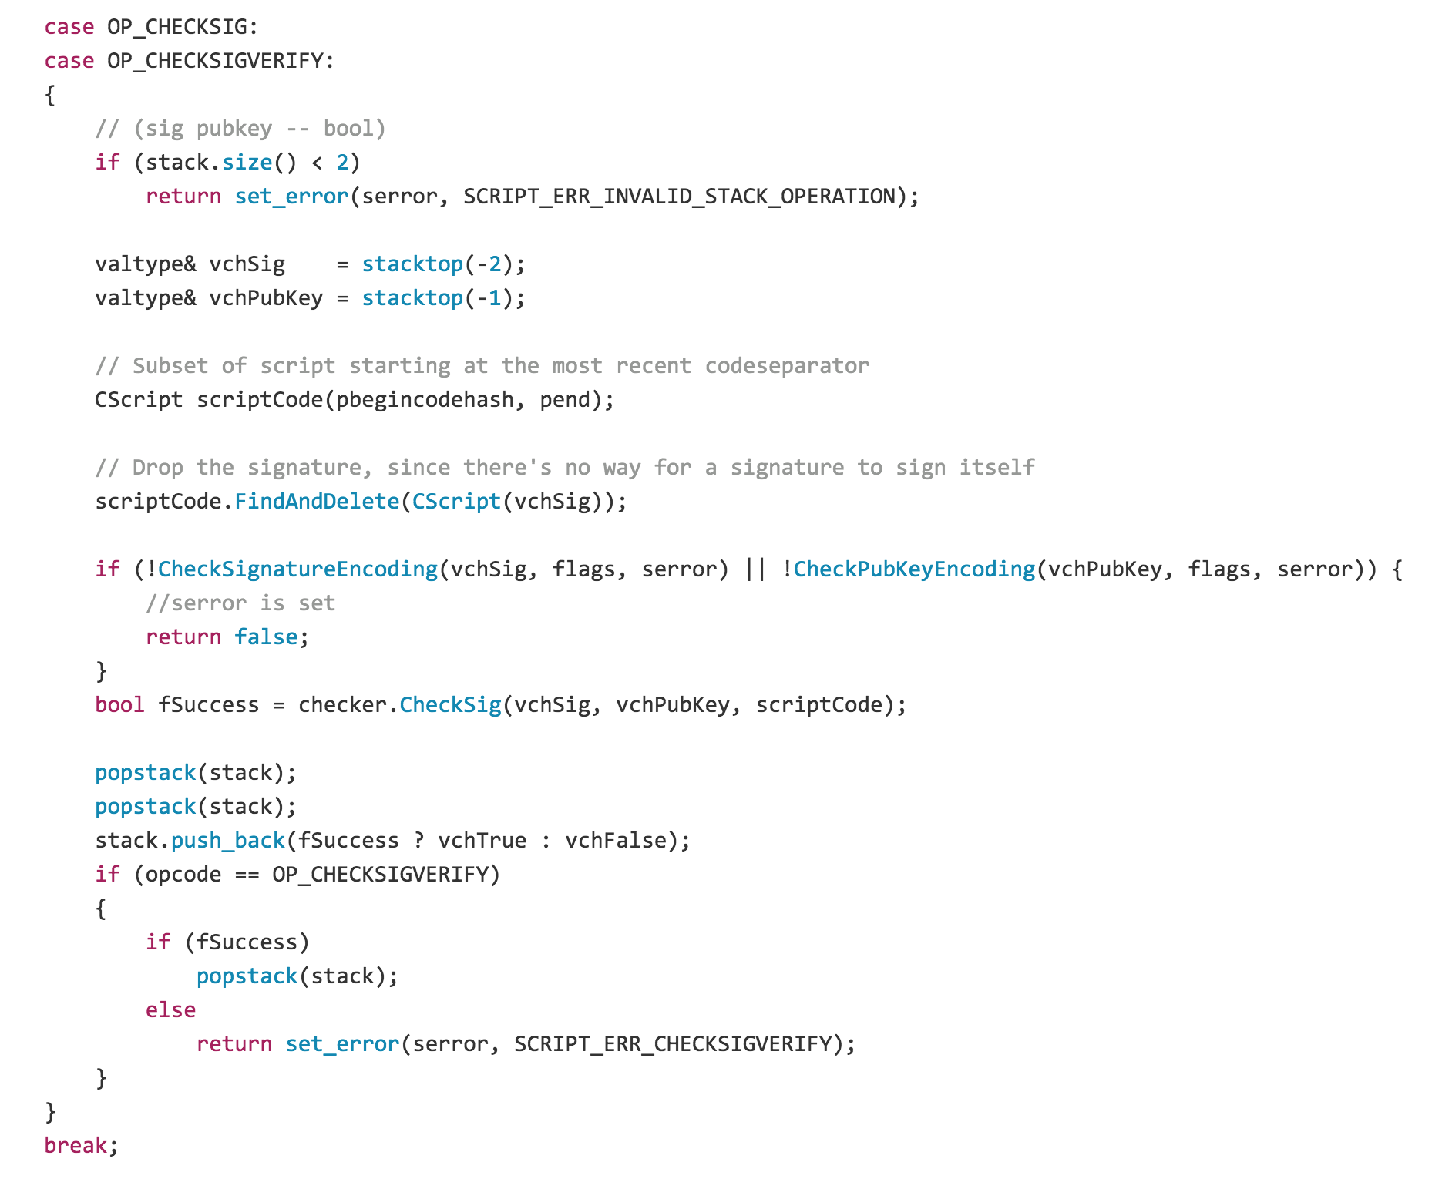

Slide 20
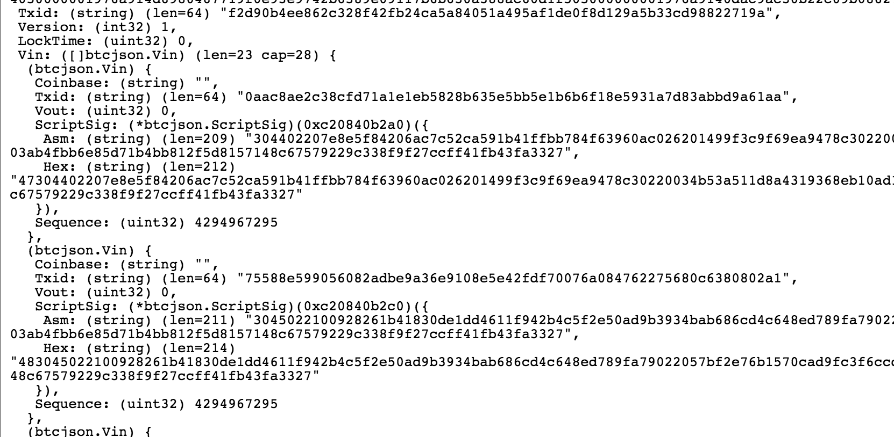
Unlocking Script

Slide 21
Unlocking Script
<signature>
<pub key>

Slide 22
“Pay-to-Script-Hash”
OP_HASH160
[20-byte hash]
OP_EQUAL
Locking Script

Slide 23
Unlocking/Locking (pre-2010)
Unlocking Script
<signature>
<public key>
OP_DUP
OP_HASH160
<bitcoin address (hash of public key)>
OP_EQUALVERIFY
OP_CHECKSIG
Locking Script

Slide 24
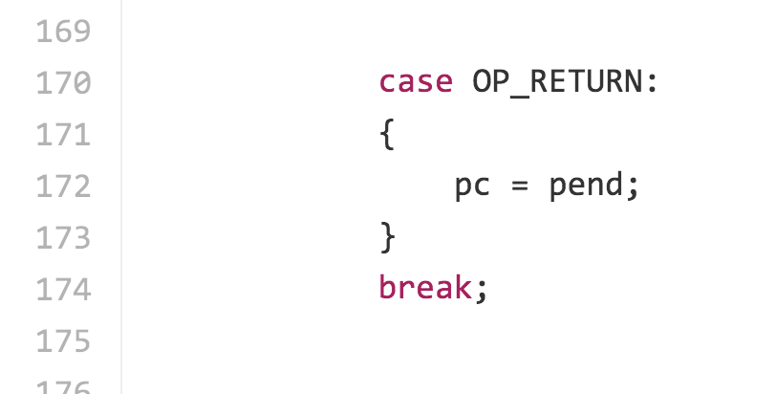
OP_RETURN
Original meaning: terminate script execution, leaving stack unchanged.
https://github.com/bitcoin/bitcoin/blob/v0.1.5/script.cpp#L170

Slide 25
Steal any output!
Unlocking Script
OP_DUP
OP_HASH160
<bitcoin address (hash of public key)>
OP_EQUALVERIFY
OP_CHECKSIG
Locking Script

Slide 26
Steal any output!
Unlocking Script
OP_DUP
OP_HASH160
<bitcoin address (hash of public key)>
OP_EQUALVERIFY
OP_CHECKSIG
Locking Script
This is the by far biggest bug in bitcoin (discovered so far!).

Slide 27
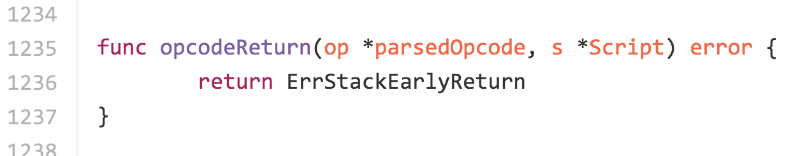
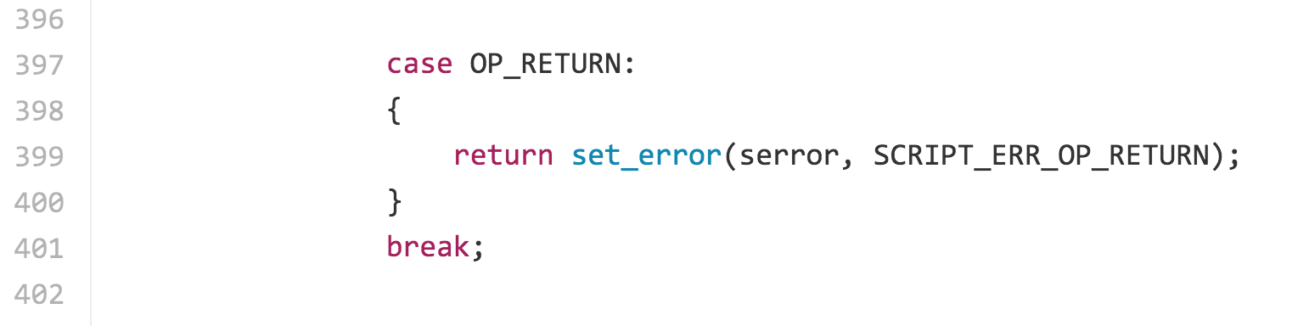
OP_RETURN (fixed July 2010)
https://github.com/btcsuite/btcd/blob/c153596542b3d87dd774c29aa5be5117ac01a234/txscript/opcode.go#L1239
https://github.com/bitcoin/bitcoin/blob/41e6e4caba9899ce7c165b0784461c55c867ee24/src/script/interpreter.cpp#L397

Slide 28
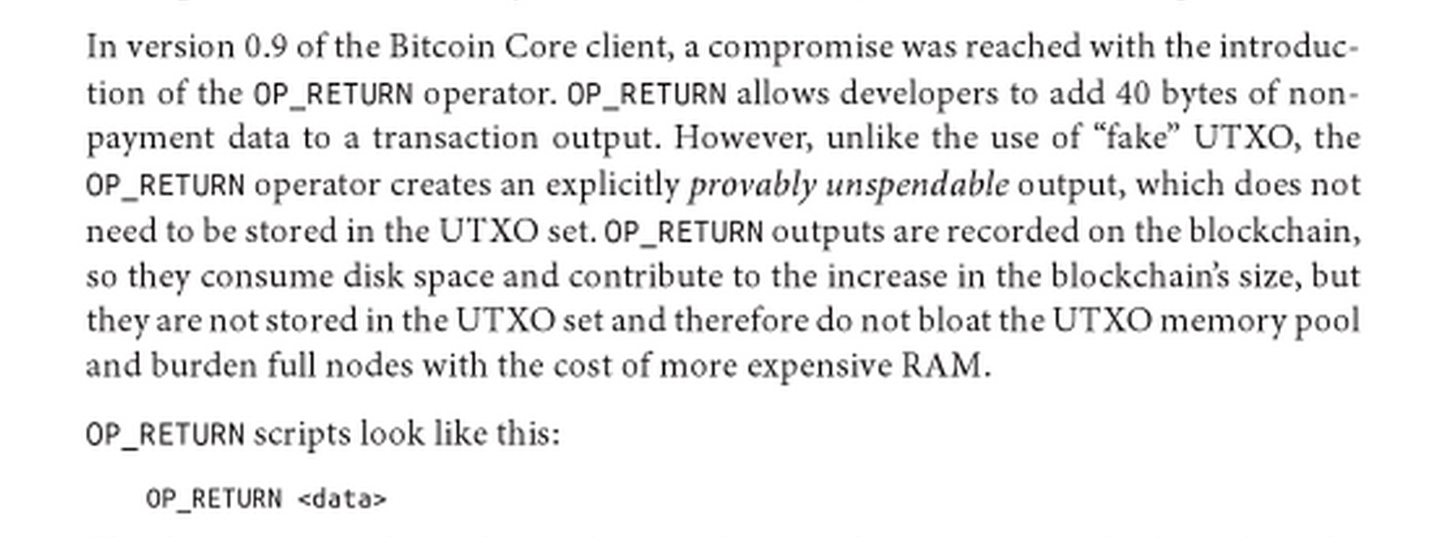
OP_RETURN (fixed July 2010)
Updated meaning: Mark transaction as Invalid.
Biggest “bug” in Antonopoulos’ book?

Slide 29
Actual Scripts in Bitcoin

Slide 30
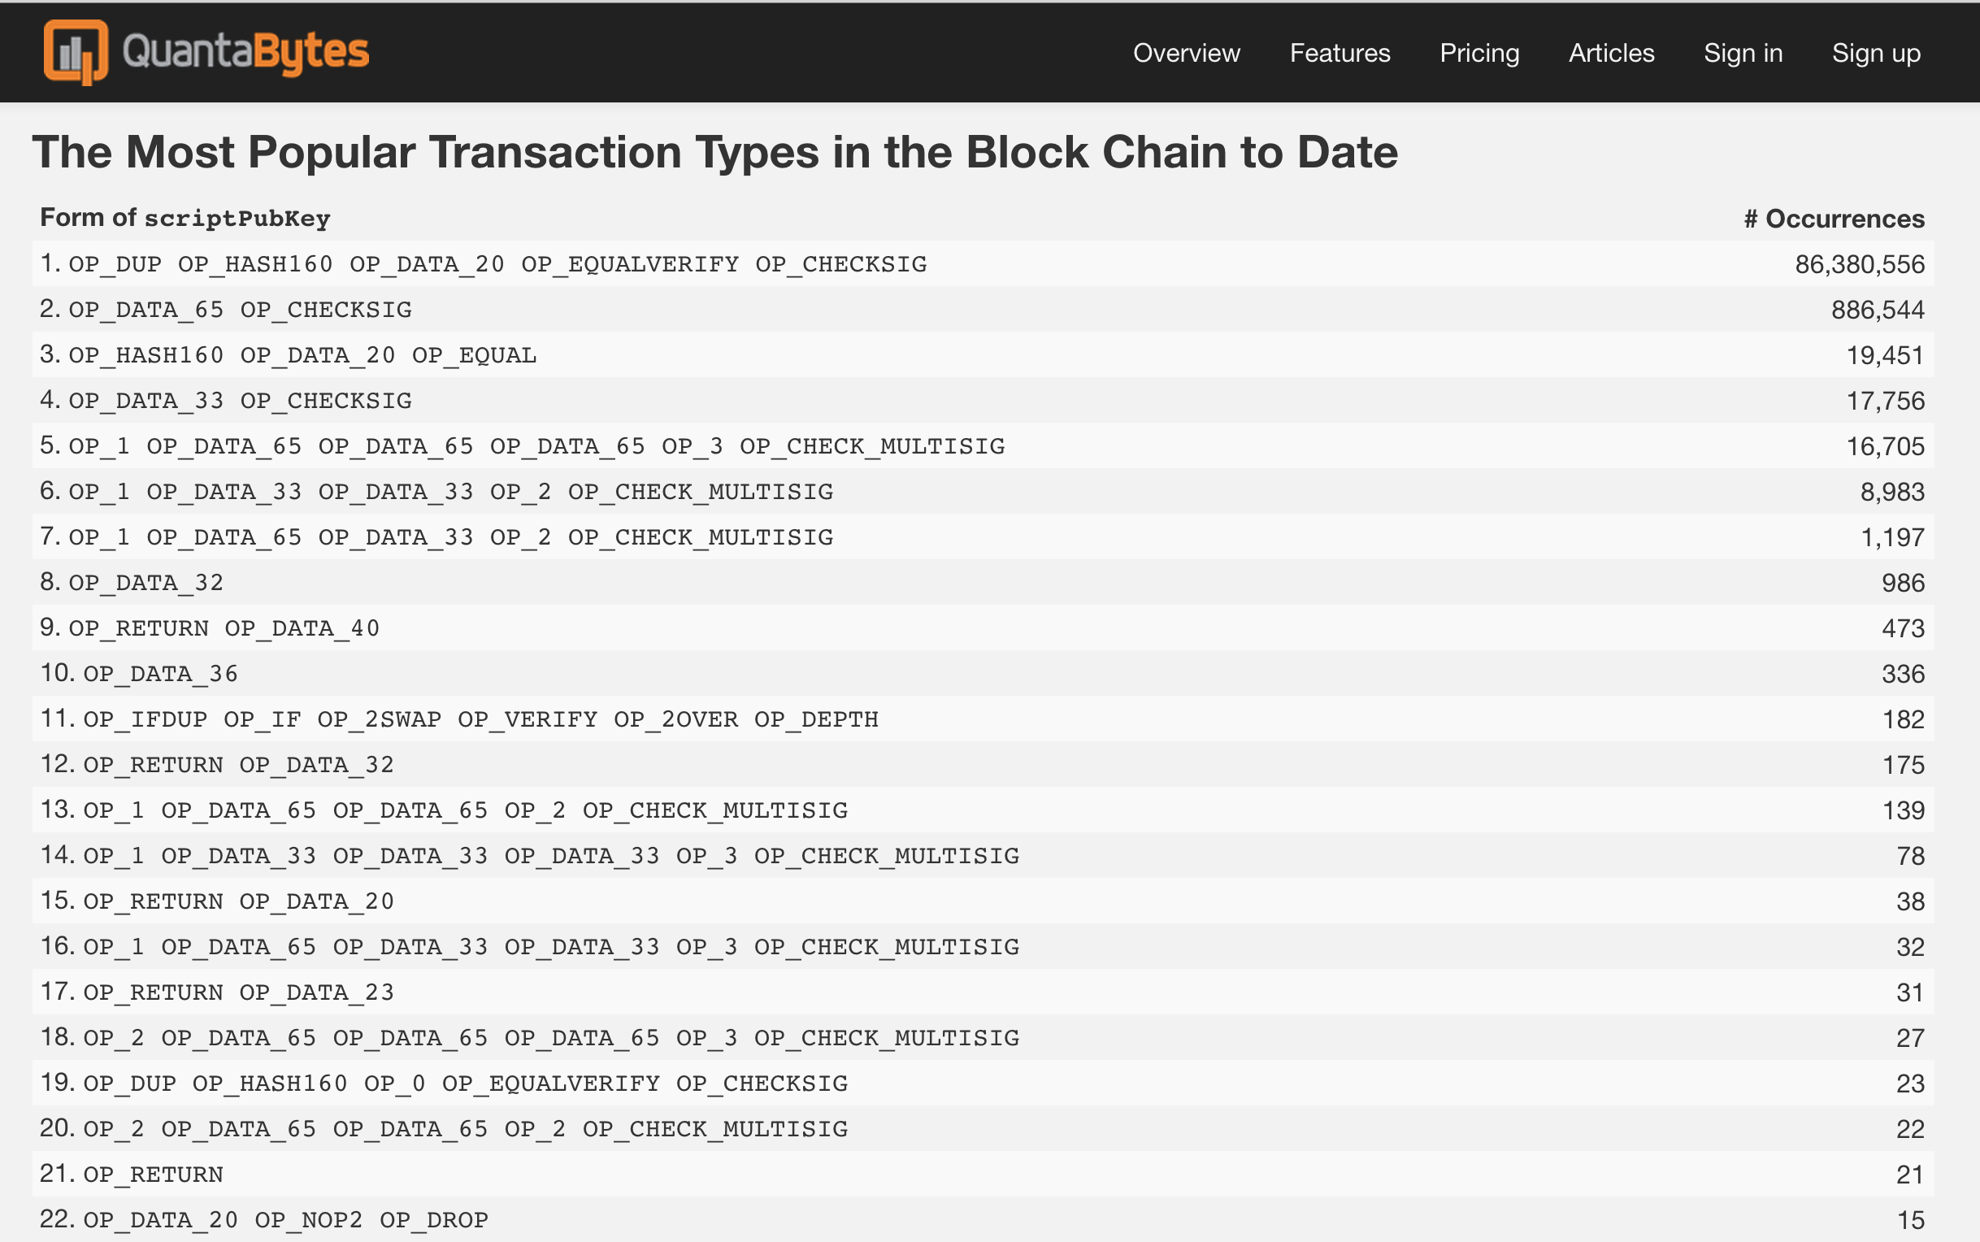
(first 290,000 blocks, through 2014-03-11)

Slide 31
^{OP_RETURN}
^{OP_DATA_40}

Slide 32
More Powerful Scripts
OP_CHECKMULTISIG [x] [sig]^{k} [pub key]^{k}
valid := 0
for each signature [1, k]:
if checksig(sig_{k}, pub_{k}): valid += 1
if valid >= x: 1
else: 0

Slide 33
Charge
Project 2 Part 2:
Due Thursday 5 March

